Slide 1

TEam
MINI PROJECT ON
404
OBJECT
DETECTION
Overview and Code Analysis

Slide 2
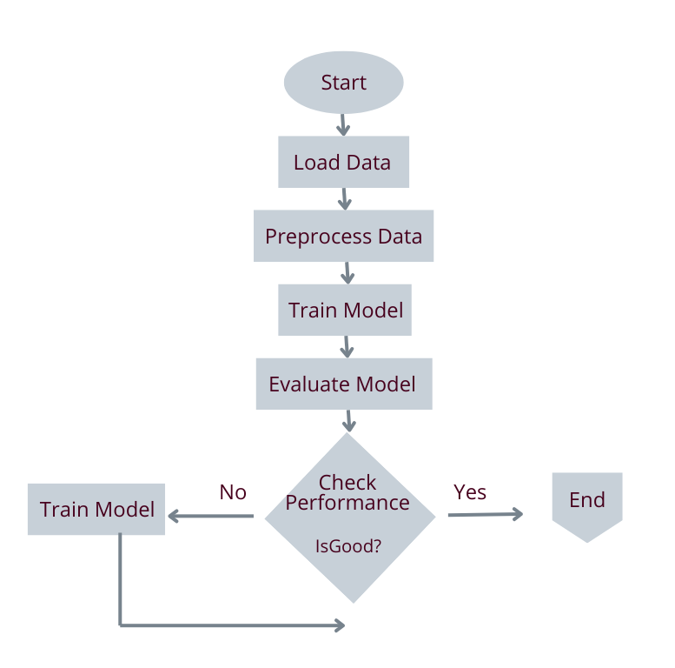
Project Overview and Objectives
TEam
404
OBJECTIVE
Develop a CNN-based model to detect objects in images using the COCO dataset.
METHODOLOGY
Load and filter dataset annotations.
Preprocess images and handle missing data.
Design a CNN for multi-label classification.
Train and evaluate the model on 25,000 images.
OUTCOME
Efficiently classify 80 object categories with the trained model.

Slide 3
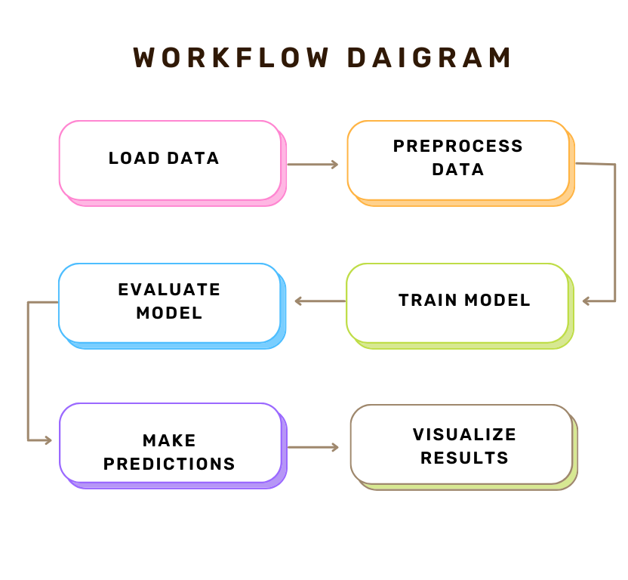
TEam
Data Loading and Filtering Annotations
404
LOADING ANNOTATIONS
Import COCO dataset annotations from JSON.
Define valid categories (IDs 1 to 80) to filter out irrelevant classes.
DATA FILTERING
Exclude missing images by using a predefined list of IDs to skip.
Keep only valid images for training to ensure model accuracy.

Slide 4
TEam
Preprocessing and Data Generator
404
IMAGE PREPROCESSING
Resize images to (128x128) and normalize pixel values to the [0, 1] range.
Simplifies data for consistent model input and faster computation.
DATA GENERATOR
Load images in batches using a generator to reduce memory usage.
Efficiently labels images with valid category IDs for multi-label classification.

Slide 5
CNN Model Architecture
MODEL DESIGN
Uses convolutional and pooling layers for feature extraction.
Flatten layer followed by Dense layers for classification.
OUTPUT LAYER
Sigmoid activation for multi-label classification across 80 object categories.
Uses binary cross-entropy loss to handle independent class probabilities

Slide 6
TEam
Training and Evaluation
404
TRAINING
Model compiled with the Adam optimizer and binary cross-entropy loss.
Trained with a validation split to monitor accuracy and loss over epochs.
EVALUATION
Performance evaluated on validation data for accuracy and loss metrics

Slide 7
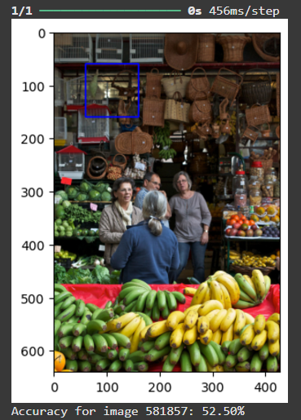
TEam
Results and Analysis
404
ACCURACY AND LOSS PLOTS
Training vs validation accuracy and loss plotted over epochs.
Analyzes model’s performance and identifies any overfitting.
Accuracy: Our model achieved 59.50% accuracy.
INSIGHTS
Observing the accuracy and loss curves helps evaluate the effectiveness of the CNN and guides further improvements.
CODE SNIPPET

Slide 8
TEam
Conclusion and Future Enhancements
404
PROJECT SUMMARY
Developed an object detection model on the COCO dataset with a multi-label CNN.
Achieved a validation accuracy suitable for real-world applications.
FUTURE SCOPE
Explore deeper CNN architectures for enhanced accuracy.
Fine-tune with a larger dataset or implement transfer learning.
Test the model on real-world images and deploy as an application.

Slide 9
TEam
Our Team Members
404
Vaibhav Sakharwade
Rohit Bisen
ugmr20230012@ihub-data.iiit.ac.in
ugmr20230017@ihub-data.iiit.ac.in
Sarang Walke
Ansh Agraval
ugmr20230022 @ihub-data.iiit.ac.in
ugmr20230043@ihub-data.iiit.ac.in
Akanksha Raut
Aakarsh B
ugmr20230021@ihub-data.iiit.ac.in
ugmr20230045@ihub-data.iiit.ac.in

Slide 10

TEam
404
THANK YOU
⁓TEAM 404

